Slide 1
Natural Language Processing

Slide 2
Definition of NLP
The development of NLP application is challenging because computer traditionally require human to speak
Common NLP task
Deep analytics
Named entity extraction
Co-reference re solution
If you use natural processing for research the program will recognize that cloud computing is an entity.

Slide 3
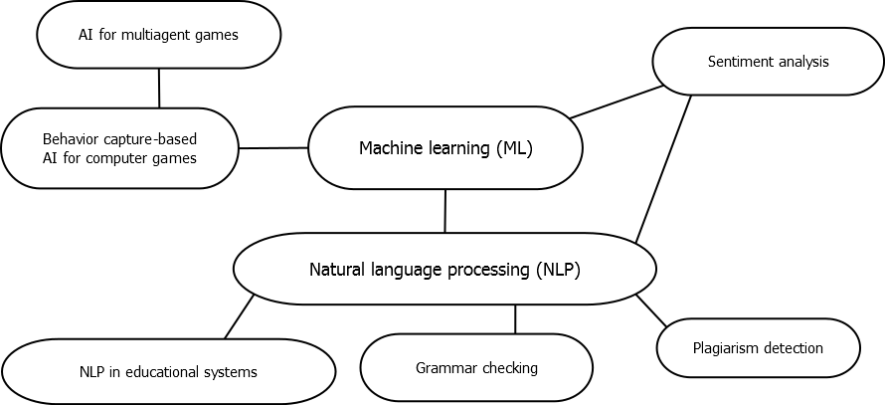
How it works

Slide 4
Applications of NLP
As technology is increasingly making the methods and platforms on which we communicate ever more accessible, there is an even greater need to understand the languages we use to communicate. By combining the power of artificial intelligence, computational linguistics and computer science, Natural Language Processing (NLP) help machine read text by simulating the human ability to understand language.
Machine translation
Fighting spam
Information extraction

